Slide 1
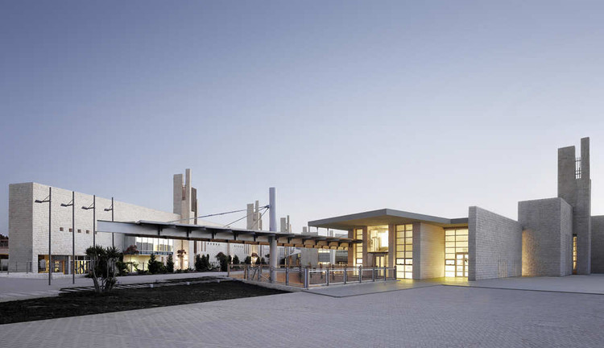
Grade 12 – Class of 2021
Mid Year Meeting
“The International Academy, Amman”, www.conexjo.com,2019, https://www.conexjo.com/portfolio/the-international-academy-amman/

Slide 2
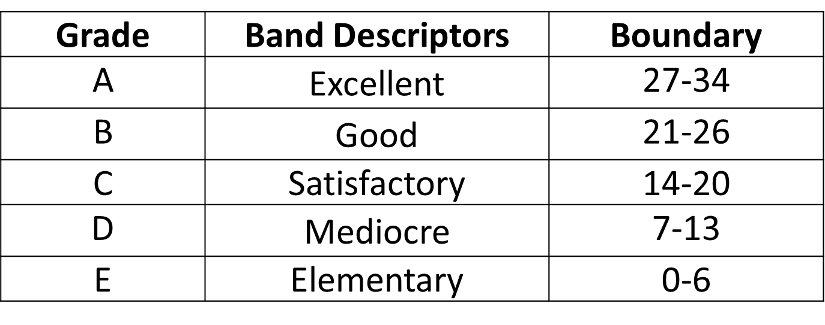
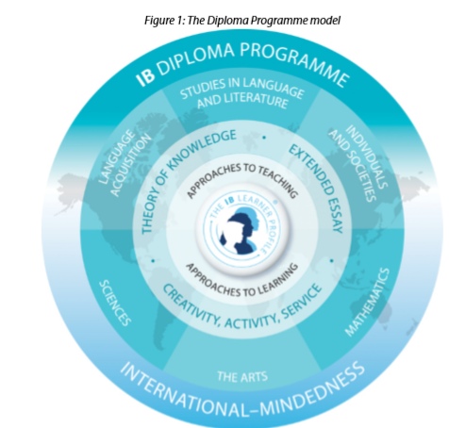
The Extended Essay is out of 34 marks.

Slide 3
Diploma Points Matrix

Slide 4

The Final Countdown: 4 chapters
Chapter 1 – Sept. & October; leading to PR1 and Uni. Predicted Grades
Chapter 2 – November & December; students really struggling with the demands of Internal Assessments looking forward to Winter Break
Chapter 3 – January & February; Sem 1 report and finishing all eCoursework
Chapter 4 – March & April; Mock exams, last IAA report and preparing for finals
“The final countdown”, www.besttillblognz.nz 2016, https://www.bestillblog.nz/single-post/2016/11/16/The-final-countdown
“Animated Zaltana Fortune Teller”, www.grandinroad.com,2020, https://www.grandinroad.com/animated-zaltana-fortune-teller/905492

Slide 5
Internal Assessment | Date Due
Biology IA Draft / Final | December 13th / 27th January
ESS IA Report Draft / Final | December 13th / 27th January
Chemistry IA Draft / Final | December 14th / 29th January
History IA HL Draft / Final | December 15th / 28th January
Economics IA No.3 Draft / Final | 17th December / 7th January
VA HL Draft: Comparative Study | 4th January/ 14th January
Psychology HL IA Final | 10th January
Spanish B HL IO | 12th January
Tok Essay Draft / Final | 13th January / 14th February
English B HL IO | 16th January
Business HL/SL Final | 21st January
VA Process Portfolio Draft | 25th January
Maths A&A (HL/SL) and A&I (SL) Final | 31st January
DT IA Project SL/HL Crit A-C Final | 7th February
VA Submission of Process Portfolio/CS | 18th March
VA Submission of Exhibition | 18th March
“The final countdown”, www.besttillblognz.nz 2016, https://www.bestillblog.nz/single-post/2016/11/16/The-final-countdown
Chapter 3 – January & February; Sem 1 report and finishing all eCoursework

Slide 6
REMINDER: Importance of Academic Integrity
ALL Internal Assessment will be submitted to the IB
Staff will be asked to double check the authenticity of submitted work and follow up on any suspicions of ‘outsourcing’
“Ensuring Academic Integrity and Information Organisation”, www.medium.com,2019, https://medium.com/@apeksha.0503/ensuring-academic-integrity-and-information-organization-c4bcc1fbb5cd

Slide 7

CAS (Creativity, Activity, Service)
Deadlines this year:
27th September
3rd January
1st March FINAL DEADLINE
Second round of interviews started
at the start of November

Slide 8
CAS examples of experiences and projects
Online cooking courses (creativity and service)
Online football/basketball skills course (activity and service)
Tutoring for younger students (service)
Helping elders with groceries and donations to old age homes (service)
Learn a new skill and take an online class through Coursera, Udemy, Khan Academy or many of the other online learning platforms (creativity, maybe activity if it's a sports class)
Do sports challenges with friends and neighbors i.e. who can hold a plank the longest? Football tournaments etc. (activity)
Host a live Zoom session with your friends for some mindful yoga or Pilates. Maybe even open up the class to their family and other friends (activity)
Start taking care of your diet - analyse your diet and create an informed nutritional plan with recipe ideas and juice recipes. You could use the website HappyForks or the myfood24 app (creativity, activity)
Reach beyond your local community, and volunteer to teach English/Arabic to helpers at home or maybe even an ex-pat teacher or student (creativity)
Support the elderly or needy community in Amman or outside the city with grocery runs and donating them through local charities and institutions (service)

Slide 9
Chapter 4 – March & April; Mock exams, last IAA report and preparing for finals
Date | Event
Sunday 21st March – Thursday 1st April | Mock Exams
Tuesday 13th April – Thursday 22nd April | Study Leave
Friday 23rd April – Monday 3rd May | Spring Break
Thursday 29th April until Thursday 20th May | IB Exams
“The final countdown”, www.besttillblognz.nz 2016, https://www.bestillblog.nz/single-post/2016/11/16/The-final-countdown

Slide 10
